Slide 1
Lesson 3.9
Planning and Cooperation
CGPRT(W) : Ensuring Clean Seas and Coasts in Western Region ……

Slide 2
Objective
To understand the organizational aspects to be considered when implementing national and/or regional contingency planning.
To understand the role of the Competent National Authority, how to establish a response organization, the benefits of cooperation with industry and the development of a tiered response system.
CGPRT(W) : Ensuring Clean Seas and Coasts in Western Region ……

Slide 3
Introduction
Overview
Purpose of a contingency plan
Hierarchy of plans
Tiered response
Planning
Cooperation
Plan development
Plan content
CGPRT(W) : Ensuring Clean Seas and Coasts in Western Region ……

Slide 4
Planning Overview
Responding to oil spills demands that a variety of decisions are made very quickly.
This can only be achieved if all participants:
are prepared
can make crucial decisions
can mobilize appropriate resources without hesitation and minimal delay
A fully developed and tested contingency plan will assist in achieving these goals.
CGPRT(W) : Ensuring Clean Seas and Coasts in Western Region ……

Slide 5
Purpose of a Contingency Plan
“A predetermined sequence of communications and actions which can be quickly initiated to cope with an event of possible but uncertain occurrence.”
Provide a framework to respond to an oil spill or potential spill
Ensure that broad consensus has been achieved on response measures, prior to the incident
Meet or set legislative requirements
CGPRT(W) : Ensuring Clean Seas and Coasts in Western Region ……

Slide 6
Hierarchy of Contingency Plans
Preparation of detailed and specific plans
International level – bilateral or regional
National level – the strategic plan
Local level – the operational plans
  Ports, oil handling installations, offshore units, vessels
CGPRT(W) : Ensuring Clean Seas and Coasts in Western Region ……

Slide 7
Hierarchy of Contingency Plans
National Plan
Area or Port Plans
Terminal, Installation, Vessel Plans
International Plans
CGPRT(W) : Ensuring Clean Seas and Coasts in Western Region ……

Slide 8
Hierarchy of Contingency Plans
Plans to be coordinated under a national system.
The framework of interlocking plans is often referred to as “tiered response”.
This is intended to ensure that the response undertaken reflects the scale of the incident.
Typically three tiers of response are recognized but different countries may have differing approaches.
CGPRT(W) : Ensuring Clean Seas and Coasts in Western Region ……

Slide 9
Tiered Response Concept
Tier One
  Resources necessary to handle a local spill and/or provide an initial response
  Generally a minor “operational” spill
    Hose burst, tank overflow, leaking flange
  Contained locally
  Local response with resources immediately available on site
  Local Contingency Plan
    reflects the local risk assessments
    reflects the local environmental sensitivities
    compatible with area contingency plan
CGPRT(W) : Ensuring Clean Seas and Coasts in Western Region ……

Slide 10
Tiered Response Concept
Tier Two
  National or regional resources necessary to supplement a Tier One response
  Generally a medium-sized spill or a spill that is not contained locally
    Collision, grounding, sub-sea leak
  Requiring additional resources from outside those immediately available on site
  Area Contingency Plan
    reflects area risk assessments
    reflects area environmental sensitivities
    compatible with national contingency plan
CGPRT(W) : Ensuring Clean Seas and Coasts in Western Region ……

Slide 11
Tiered Response Concept
Tier Three
  Global resources necessary for spills that require a substantial additional response
  Generally a significant spill with national consequences or regional consequences
    Grounding or loss of vessel, blow-out, major sub-sea leak
  Not contained locally, possible cross-boundary movement
  National, Bilateral or Regional Plans activated
  National Contingency Plan
    reflects national risk assessments
    reflects national environmental sensitivities
    compatible with regional contingency plan
CGPRT(W) : Ensuring Clean Seas and Coasts in Western Region ……

Slide 12
Planning Overview
Contingency plans provide the structure under which the response will be managed.
They should:
reflect the needs of the country
reflect the working culture of the country
be concise
be accessible
be easily updated
CGPRT(W) : Ensuring Clean Seas and Coasts in Western Region ……

Slide 13
Planning Overview
A contingency plan need not be one volume.
One volume plans may be appropriate at the local level but are often too large at the national level.
They should be developed to meet the needs and policies of the country but be adaptable to meet any changes in the future.
CGPRT(W) : Ensuring Clean Seas and Coasts in Western Region ……

Slide 14
Cooperation
Cooperation is essential in both the planning and response phases.
Within the national context all stakeholders need to be included in the national plan.
There are many possible stakeholders, some with significant input, some with lesser input.
In order to manage the national plan and the input of stakeholders, consideration may be given to creating a coordinating committee plan.
CGPRT(W) : Ensuring Clean Seas and Coasts in Western Region ……

Slide 15
Coordinating Committee
The coordinating committee should comprise key stakeholders with responsibility for spill response.
It should be chaired by the national competent authority.
The committee should invite other stakeholders, as required.
The function of the committee is to manage the national preparedness including preparation, training and exercising.
CGPRT(W) : Ensuring Clean Seas and Coasts in Western Region ……

Slide 16
Planning Overview
The planning process is very important:
It raises awareness of the issues likely to be faced.
It brings stakeholders together to discuss and resolve potential conflicts.
It allows for plans to be drafted outside of the intensity of response operations.
It is best drafted by the users.
CGPRT(W) : Ensuring Clean Seas and Coasts in Western Region ……

Slide 17
Seven Steps in Plan Development
7. Update plan
6. Conduct training and exercise
5. Procure appropriate equipment
4. Decide structure and layout
3. Develop a strategy
2. Conduct the risk assessments
1. Define scope of the plan
CGPRT(W) : Ensuring Clean Seas and Coasts in Western Region ……

Slide 18
Development Process
CGPRT(W) : Ensuring Clean Seas and Coasts in Western Region ……

Slide 19
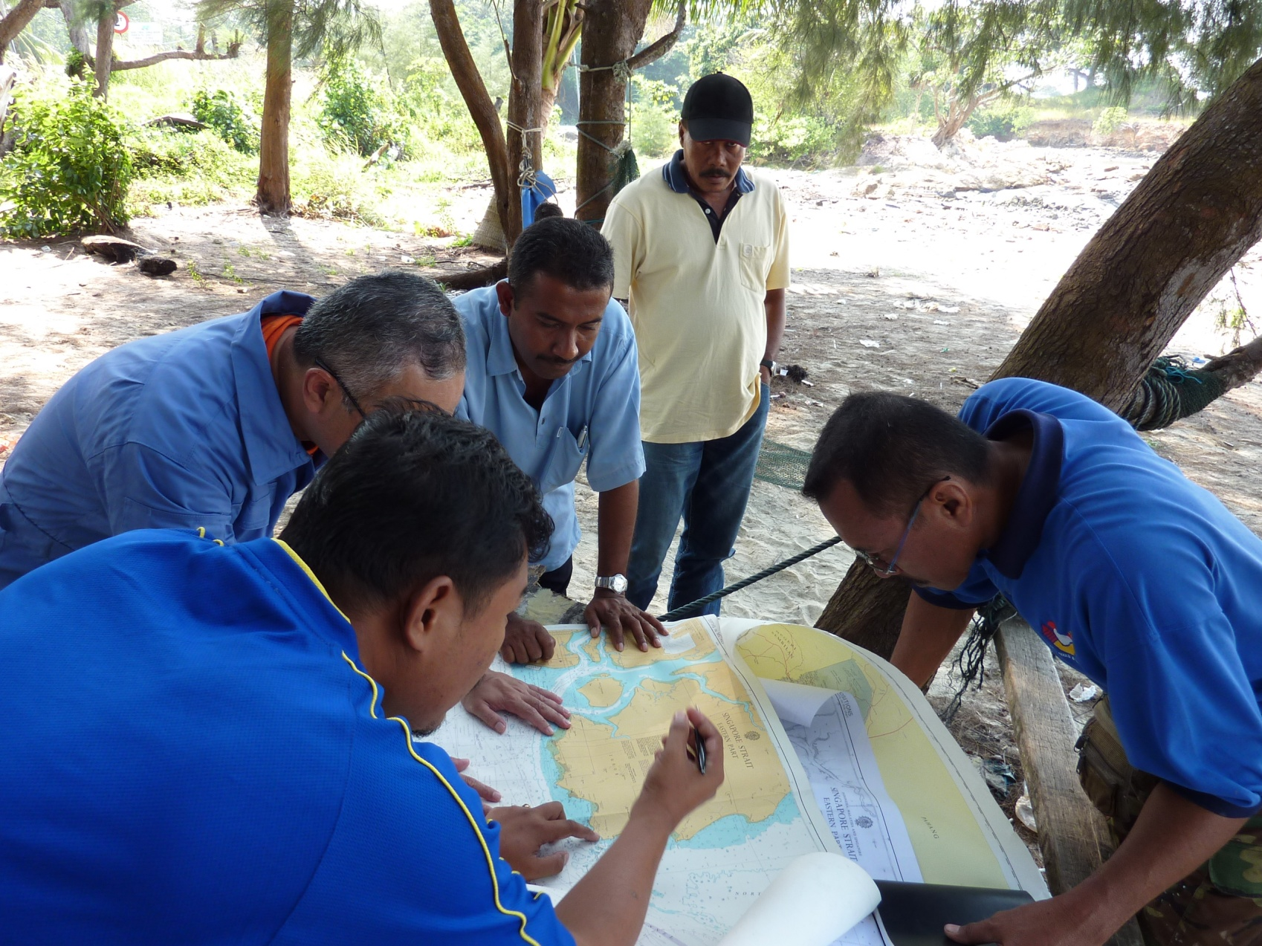
Development Process
CGPRT(W) : Ensuring Clean Seas and Coasts in Western Region ……

Slide 20
Plan Contents
Risk assessment
Determine
  the likelihood of a spill occurring
  the probable consequences
  likely scenarios
  plan requirements
  plan scope
CGPRT(W) : Ensuring Clean Seas and Coasts in Western Region ……

Slide 21
Plan Contents
Analyse hazards and
possible scenarios
Analyse
probabilities
Analyse
consequences
Characterize the risk
Risk
management
Options to
Options to
reduce
reduce
probability
consequences
CGPRT(W) : Ensuring Clean Seas and Coasts in Western Region ……

Slide 22
Plan Contents
Strategic policy
plan overview
  regulatory framework
  lead and key organization
  geographical limits
  interaction with other plans
response techniques
management
resources
CGPRT(W) : Ensuring Clean Seas and Coasts in Western Region ……

Slide 23
Plan Contents
Operational procedures
notification
evaluation
initiation
mobilization
logistical support
response management
termination
post-incident operations
CGPRT(W) : Ensuring Clean Seas and Coasts in Western Region ……

Slide 24
Plan Contents
Information directory
contact details
inventory of resources
third party suppliers
environmental sensitivity maps (GIS)
proforma reports and forms
proforma charter or hire agreements
appropriate supplementary information
CGPRT(W) : Ensuring Clean Seas and Coasts in Western Region ……

Slide 25
Seven Steps in Plan Development
7. Update plan
6. Conduct training and exercise
5. Procure appropriate equipment
4. Decide structure and layout
3. Develop a strategy
2. Conduct the risk assessments
1. Define scope of the plan
CGPRT(W) : Ensuring Clean Seas and Coasts in Western Region ……

Slide 26
Summary
We have considered the organizational aspects to be considered when implementing National and/or Regional Contingency Planning.
We have looked at the role of the Competent National Authority, how to establish a response organization, the benefits of cooperation with industry and the development of a tiered response system.
CGPRT(W) : Ensuring Clean Seas and Coasts in Western Region ……

Slide 27
Any questions?
CGPRT(W) : Ensuring Clean Seas and Coasts in Western Region ……

